Slide 1
Julian Days

Slide 2
What are Julian Days?
The Julian day is the continuous count of days since the beginning of the Julian period, and is used primarily by astronomers, and in software for easily calculating elapsed days between two events.
The Julian date is widely used with computers because it requires less programming to compare dates that are single integers.
Julian date is commonly used in computer science to calculate the difference between days, since all numbers in the system are consecutive integers.

Slide 3
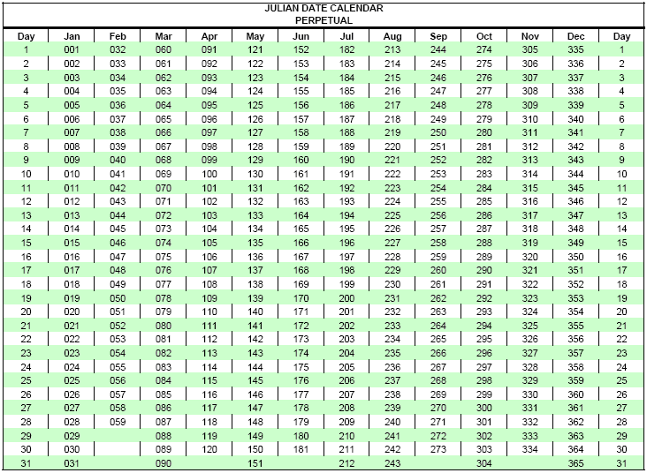
Julian Dates (DDD)

Slide 4
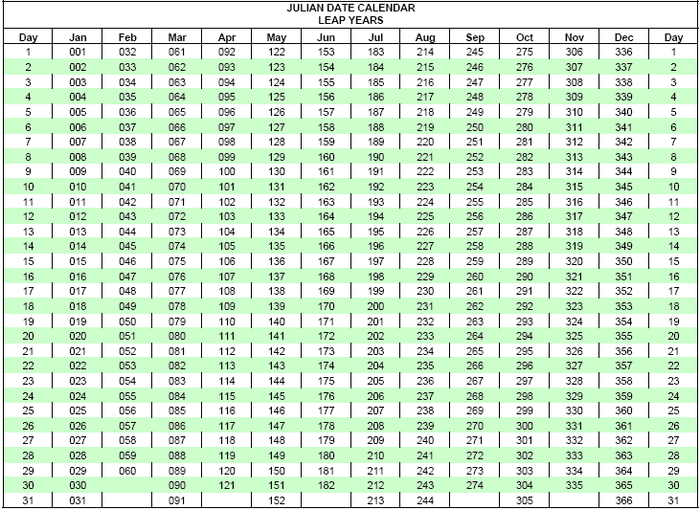
Julian Dates in Leap Year (DDD)

Slide 5
Reference Links
Calendar, Culture Info, DateTime format info
Methods (ParseExact, Subtract, AddDays)

